Slide 1
Microsoft PowerApps

Slide 2
What is PowerApps?
Customers have many data sources
Ability to view & edit data from anywhere
Compatibility with iPhone, iPad & Android devices
Ability to develop apps quickly
Do it for cheap… or free

Slide 3
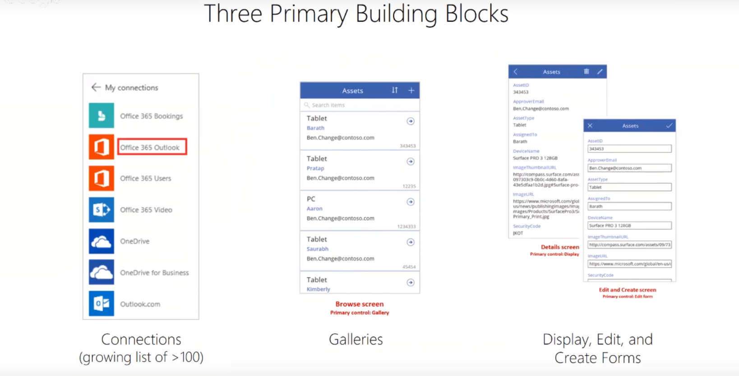

Slide 4
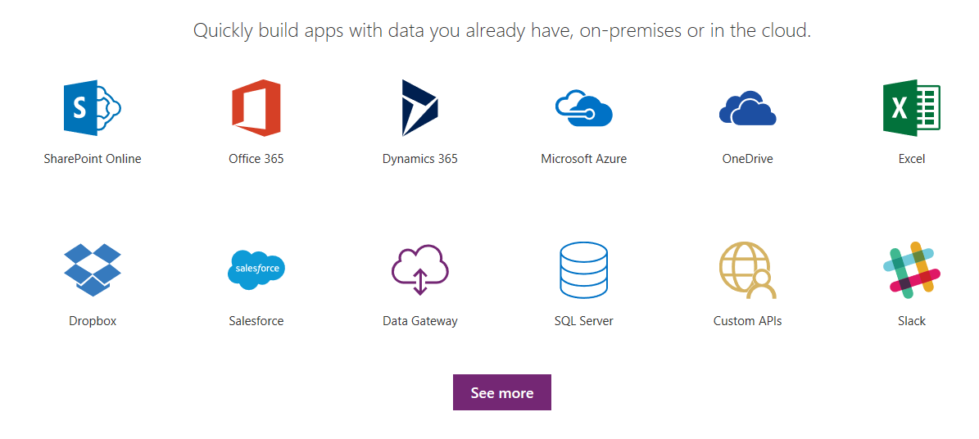
Connections

Slide 5
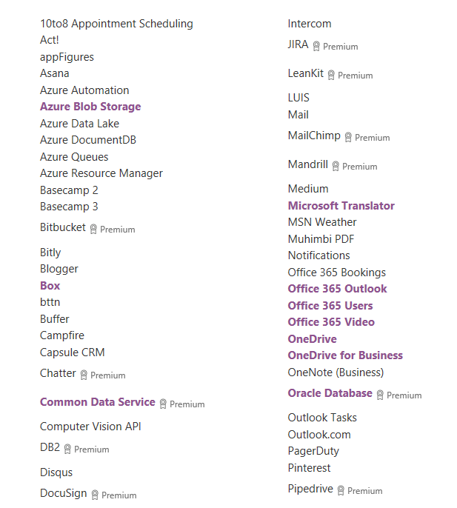

Slide 6
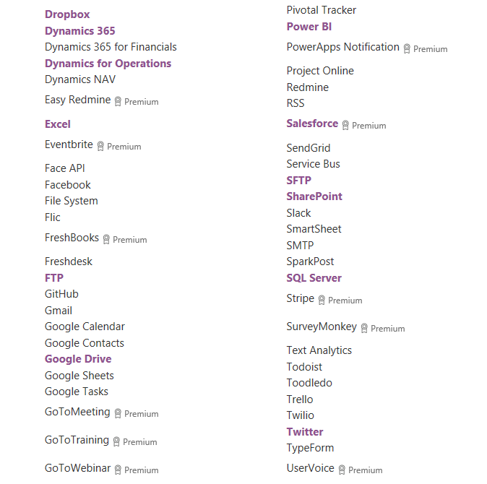

Slide 7
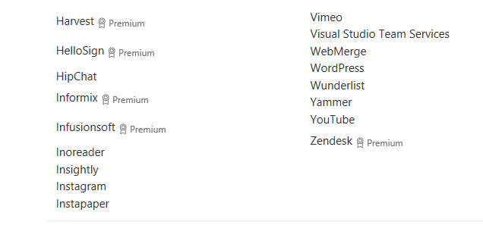

Slide 8
Editing Apps
3 Types of Views
Browse View
Read-Only View
Edit View
View the interface

Slide 9
Making them smart
Camera – video, pictures
Use voice for data entry
Geolocation
Barcode scanner
Timer
PDF viewer
Pen input - signatures

Slide 10
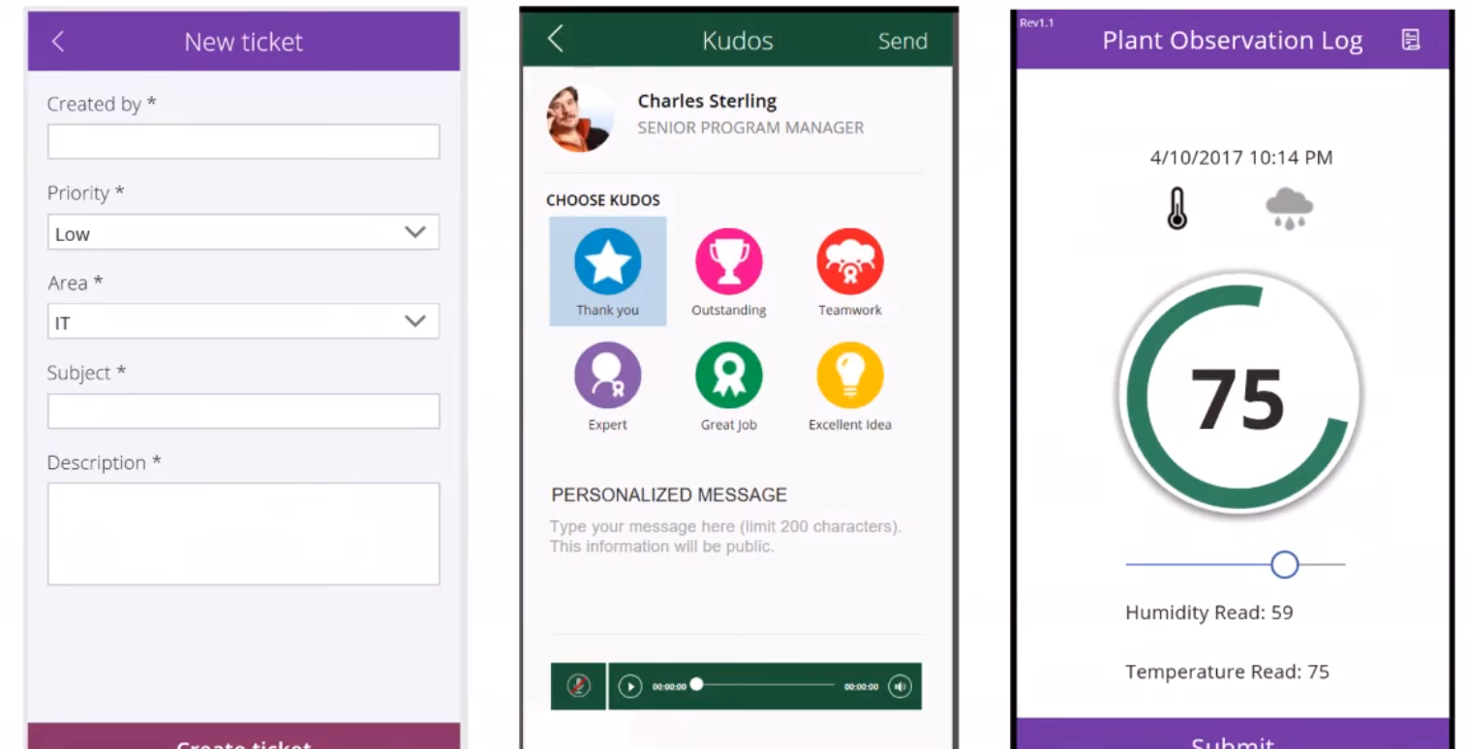
Better ways to enter data

Slide 11
How do you start?
Where to start?
Register at powerapps.microsoft.com
Create apps from the Web interface
Create apps from Desktop Studio

Slide 12
Keep in touch…
http://www.accessusergroups.org/powerapps
http://www.accessusergroups.org/ET
Andy Tabisz
Twitter: @AccessWisdom
Email: andy@worksmartdb.com
Mobile: 616-258-1408

Slide 13
BONUS SLIDES !!!
If we have enough time, Andy will touch on how Microsoft Flow and Power BI relate to PowerApps.

Slide 14
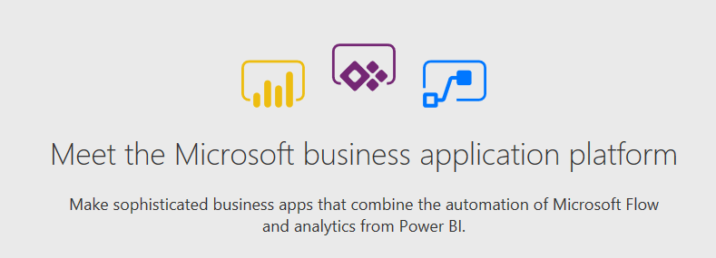
Microsoft: 3 Tools, 1 Department

Slide 15
Microsoft Power BI
Any kind of graph or chart you can think of
Once created, can be used in multiple apps
Connects to over 100 data sets
Spin-off group from the Microsoft Excel team

Slide 16
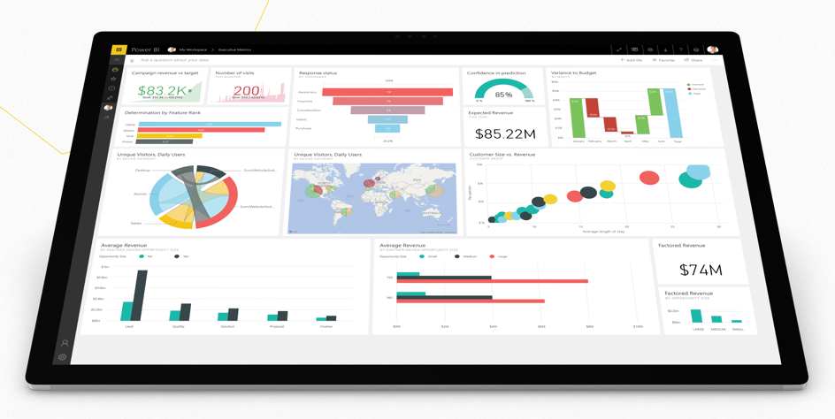
Microsoft Power BI

Slide 17
Microsoft Flow
Automate Workflows
Replacement for SharePoint’s Infopath
Once created, can be used in multiple apps
Connects to over 100 data sets

Slide 18
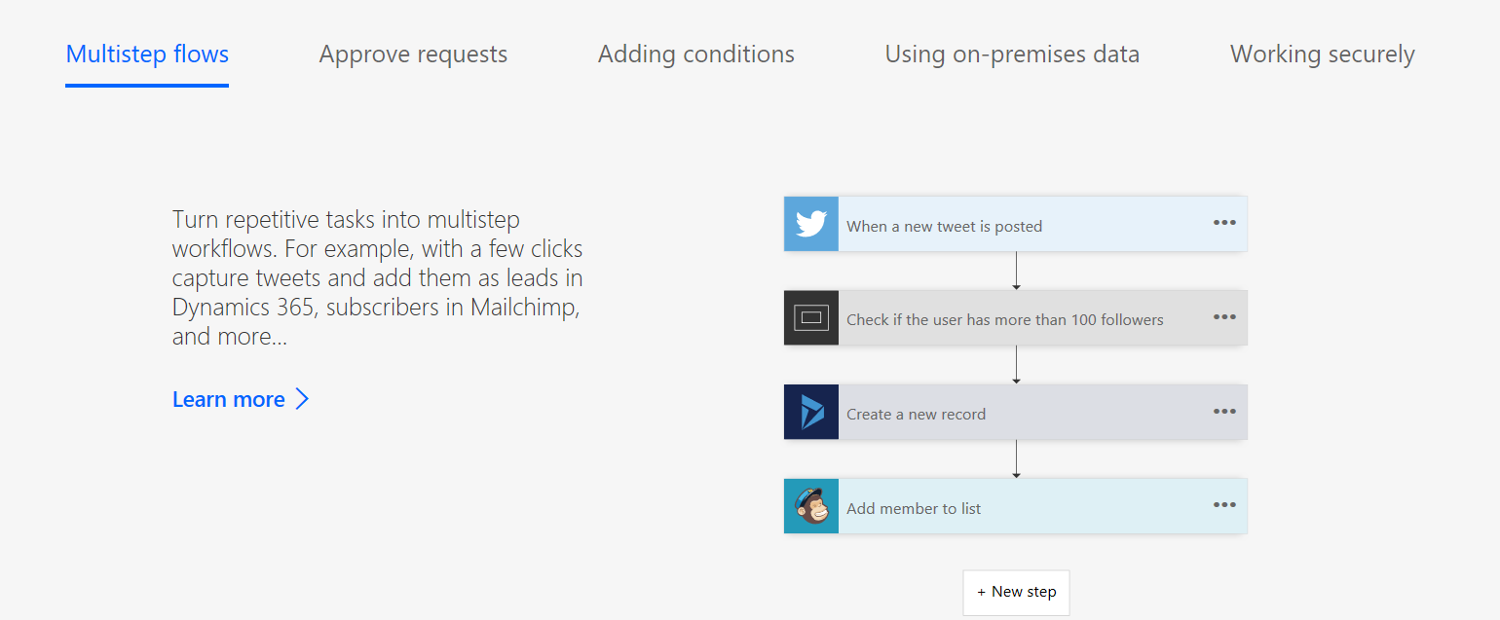
Microsoft Flow

Slide 19

About WorkSmart
Are software inefficiencies holding you back?
Unleash your inner beast. Get more done.
WorkSmart Database Masters, LLC is a tech company dedicated to eliminating all the software frustrations that keep clients from maximizing their time at work, so they can get back to what’s really important... more time with family and friends.
Learn more at www.WorkSmartDB.com.
Andy can be reached at 616-258-1408.

